Slide 1



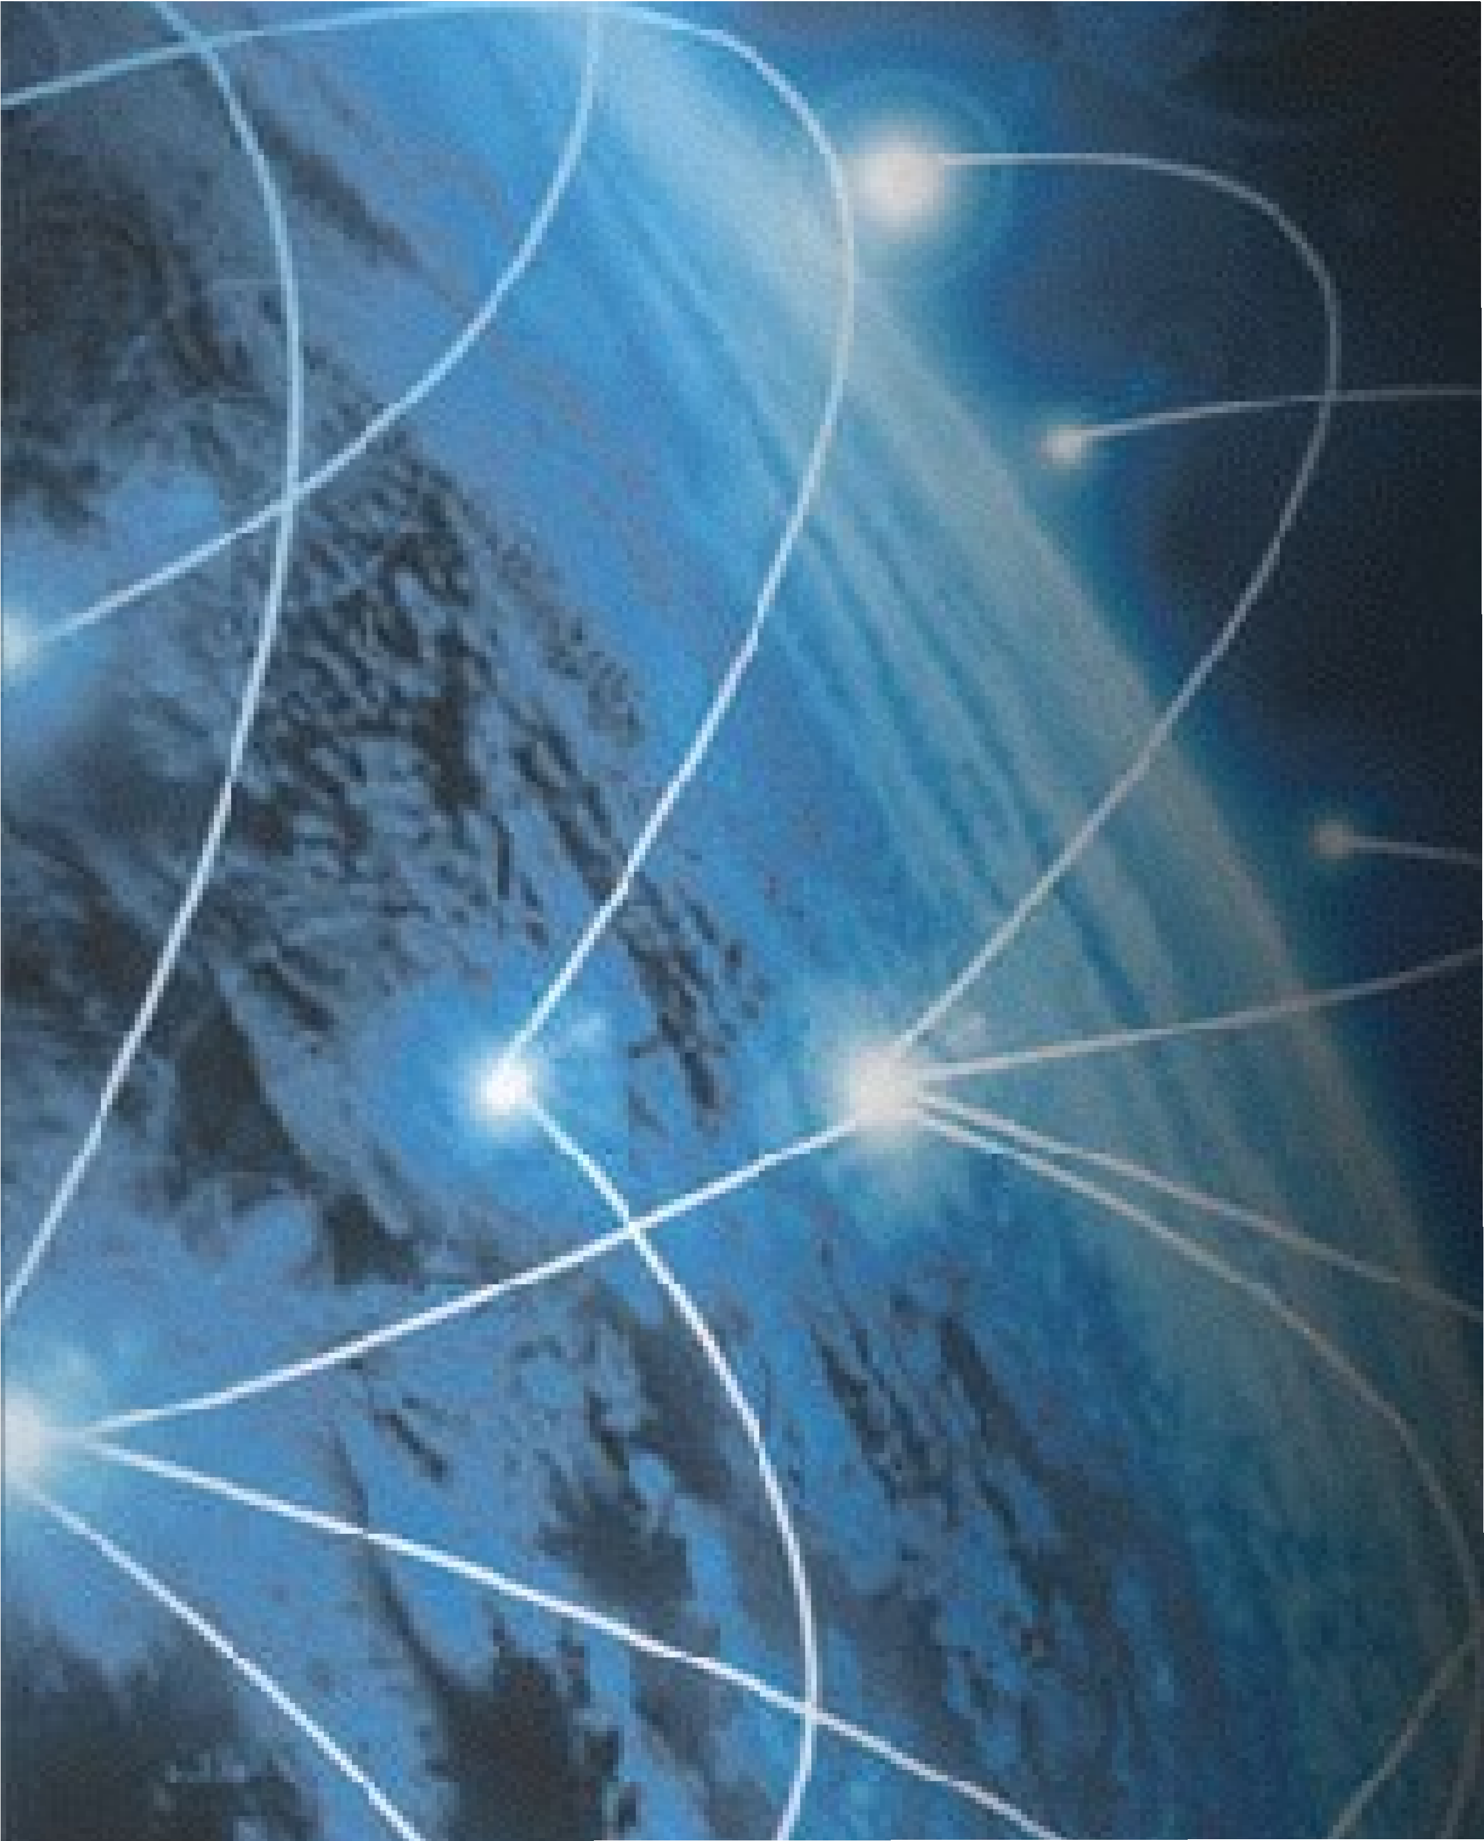




Security Usability
Comp6236
Dr Md Sadek Ferdous
www.CyberSecuritySoton.org
@CybSecSoton (fb & tw)
Notes:
To highlight the need for Security Usability. What is security usability.

Slide 2
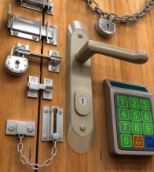
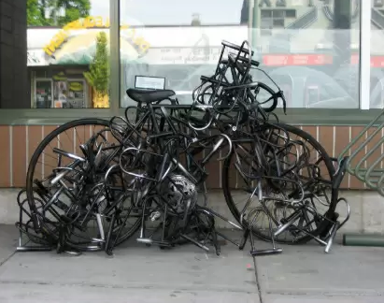
Usable Security
A secure system needs to be complicated and complex; thus, difficult to use
http://www.crime-safety-security.com/images/Door-Multiple-Locks-4788026.jpg
http://img.memecdn.com/security-fails_o_2219379.webp

Slide 3
Usable Security
A secure system needs to be complicated and complex; thus, difficult to use
‘Why Johnny Can’t Encrypt’ – study of encryption program PGP¹:
90% of users couldn’t use it properly within 90 minutes
1. https://www.usenix.org/legacy/events/sec99/full_papers/whitten/whitten.ps

Slide 4
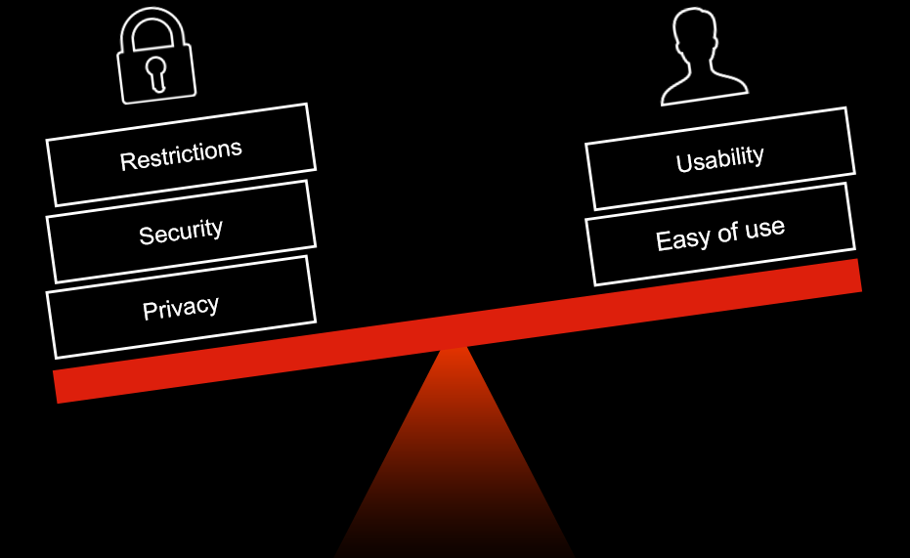
Usable Security
https://www.kaymera.com/wp-content/uploads/2015/06/balance.png

Slide 5
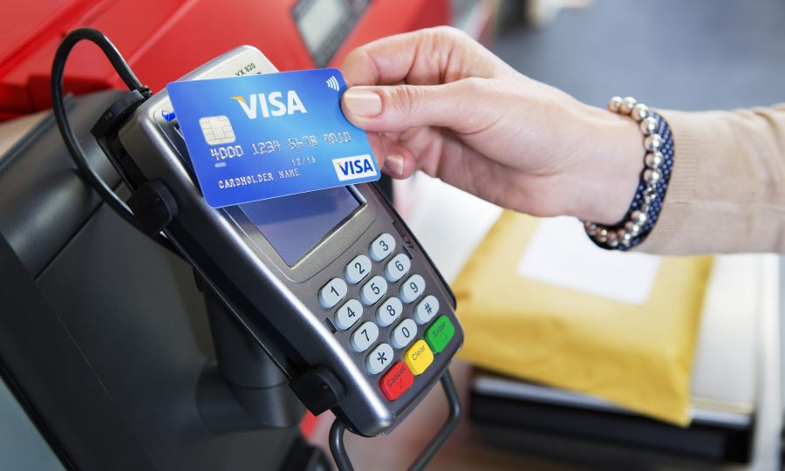
Usable Security
Usable, but no/less security
https://www.sundaypost.com/wp-content/uploads/sites/13/2016/05/Visa-Contactless-Card-1-900x540.jpg

Slide 6
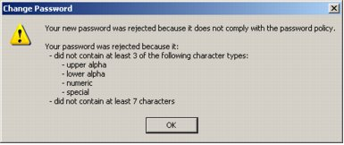
Usable Security
The opposite: secure, but probably unusable
Can’t use any old password
Change it in every three months
http://anixis.com/doc/ppe60eg/images/Password_Policy_Enforcer_08.jpg

Slide 7
Why security fails
Security is a secondary task to the user.
Users background vary:
skill, language, culture, etc.
Users have little knowledge about security
Security is complex and evolving
Users don’t understand the associated risks
Users don’t understand the system
Lack of knowledge regarding usability among security professionals

Slide 8
Security usability: importance
Crimes exploiting human factors are on rise
e.g. Phishing
Humans are the weakest link in the security chain
Often easier for hackers to exploit the human element in security than the system

Slide 9
Security usability
A set of guidelines focusing on the usability (based on different principles of psychology) and security to ensure a system is secure and usable
For best usability, a system should be:
Easy to learn
efficient to use
easy to remember
less error prone
likable

Slide 10
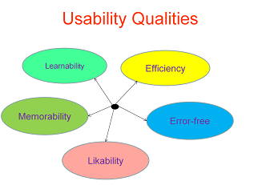
Security usability

Slide 11
Security usability: Reading list
Whitten et al.: Why Johnny can't encrypt: a usability evaluation of PGP 5.0
http://www.gaudior.net/alma/johnny.pdf
Ka-Ping Yee: Aligning Security and Usability
https://pdfs.semanticscholar.org/861b/0d7169b6ecd0d15383af585b2ed944e8f267.pdf
Adams et al.: Users are not the enymy.
http://discovery.ucl.ac.uk/20247/2/CACM%20FINAL.pdf

